Slide 1
CYWG (CyberInfrastructure Working Group)
October 2014
iDigBio Data Ingestion
Dan Stoner
Advanced Computing and Information Systems Laboratory (ACIS)
University of Florida
dstoner@acis.ufl.edu
@thatlinuxbox

Slide 2

Over 300 Data Providers...

Slide 3


Slide 4
Data Ingestion Progress
November 2013 -
4.2 million specimen records
0.9 million media records
October 2014 -
24 million specimen records
3.4 million media records

Slide 5
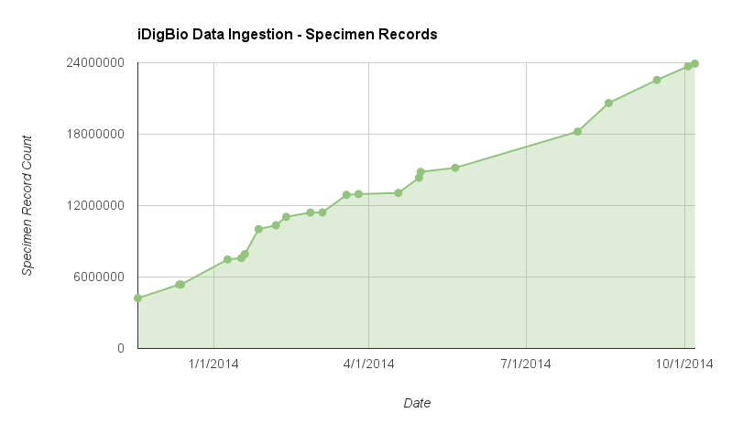

Slide 6
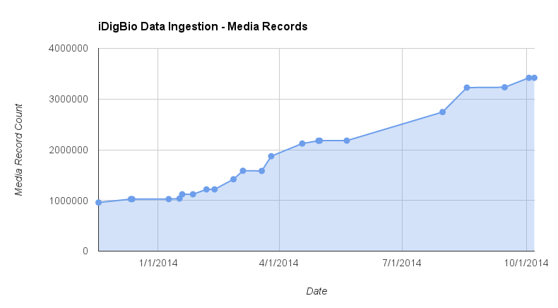

Slide 7
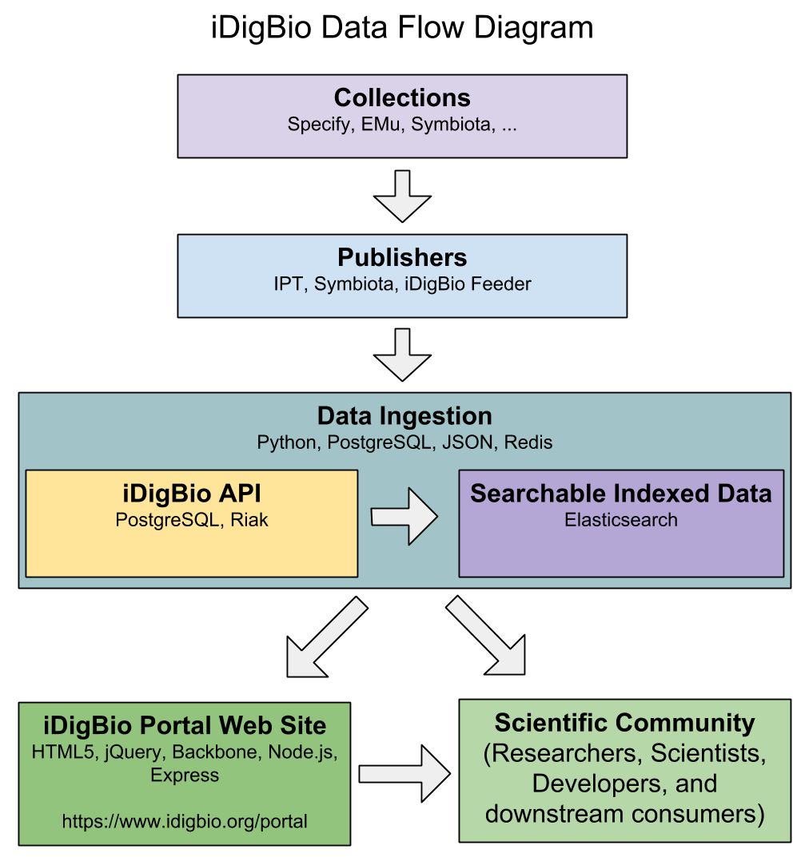

Slide 8
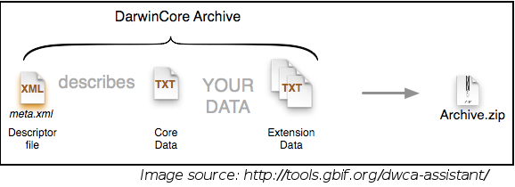
Darwin Core Archive / DwC-A
http://rs.tdwg.org/dwc/terms/guides/text/
A Darwin Core Archive is a zip file that includes metadata about the dataset, the data itself, and any optional extension data.

Slide 9
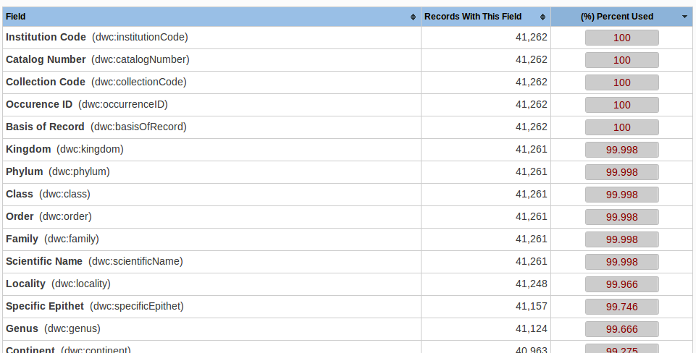
Specimen Data – Darwin Core Standard
http://rs.tdwg.org/dwc/terms/

Slide 10
Three types of data publishing technologies currently being consumed by iDigBio:
GBIF Integrated Publishing Toolkit (IPT) - a Java tool used to publish and share biodiversity datasets
http://www.gbif.org/ipt/
Symbiota – web-based collection management software
http://symbiota.org/
iDigBio RSS Feeder – data sharing service for providers who do not run infrastructure

Slide 11
Data Source Types Providing Data to iDigBio
The following collection systems, databases, applications are known to have a capability to be a data source for iDigBio.
Specify Software Project
EMu Museum Management System
Symbiota
Arctos
Excel
…
The iDigBio Mobilization Team (data@idigbio.org) assist with the preparation of data sets prior to Data Ingestion and are available to answer questions about sharing data with iDigBio.
See Also:
https://www.idigbio.org/wiki/index.php/Digitization_Resources

Slide 12
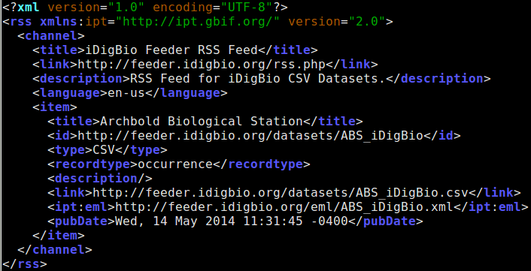
RSS is preferred format for Data Feeds
RSS (Really Simple Syndication) provides the mechanism to list available data files and share when they are updated. iDigbio reads the RSS feed to determine whether to download the data file again in order to collect updates.

Slide 13
Recommended minimum fields for iDigBio Ingestion:
Record ID (recordId) - unique identifier for the digital record
Occurrence ID (occurenceID) - unique identifier for the physical object or establishment of an Occurrence
Scientific Name (scientificName) - the full scientific name
Event Date (eventDate) - date-time, preferably in ISO 8601
Collector (recordedBy) - collector name, number, or field number
Locality Data (...) - verbatim and decimal locality fields, continent, country, water body, state/province, ….
Catalog Number (catalogNumber) - Barcode, catalog number, accession id or collection number
Institution Code (institutionID) - institution identifier
Collection Code (collectionID) - collection identifier
Paleo specimens should also include Geological Context fields.

Slide 14
Dataset File Formats Consumable by iDigBio
IPT – DwC-A
Symbiota portals – DwC-A
iDigBio Feeder – DwC-A, CSV, …
If you can export specimen data from your system / database / spreadsheet into DwC-A (or even CSV), then you can share data with iDigBio.
iDigBio RSS Feeder facilitates the sharing of over 1.5 million specimen records and 200 thousand media records from providers who do not need to run “servers”.

Slide 15
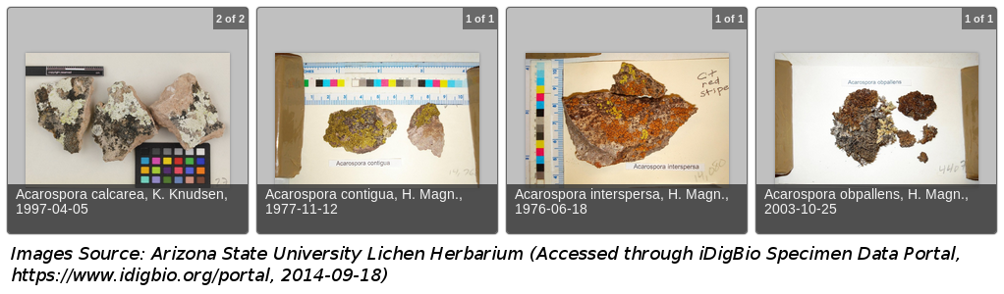
Media Data – Audubon Core / AC
http://terms.tdwg.org/wiki/Audubon_Core_Term_List
GBIF has a nice write-up on the benefits of AC over dwc:associatedMedia:
http://gbif.blogspot.com/2014/05/multimedia-in-gbif.html

Slide 16
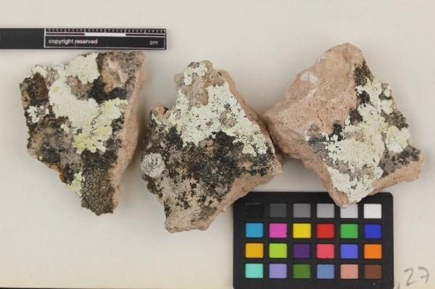
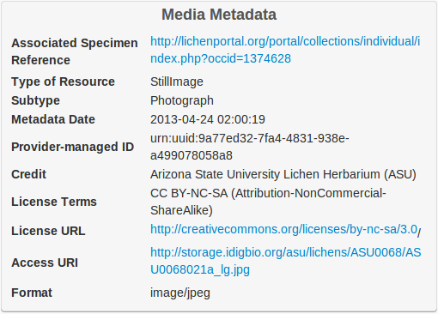
Audubon Core vocabularies address such concerns as:
- the management of the media and collections
- descriptions of their content
- their taxonomic, geographic, and temporal coverage
- appropriate ways to retrieve, attribute and reproduce them

Slide 17
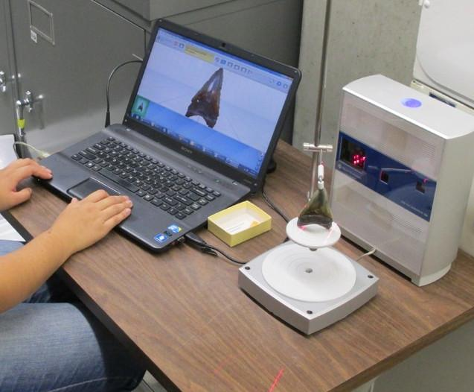
Audubon Core can support “new” media types
Specimen Data
dwc:catalogNumber: UF 105199
dwc:scientificName:
Carcharocles megalodon
dwc:stateProvince: Florida
dwc:county: Duval
dwc:latestPeriodOrHighestSystem:
Late Miocene
dwc:decimalLatitude: 30.39211
Media Data
dwc:scientificName:
Carcharocles megalodon
dc:type: image
ac:subtype: http://www.fabbers.com/StL.asp
ac:subtypeLiteral: 3dModel
ac:tag: tooth
Image source: Aaron Wood, Florida Museum of Natural History

Slide 18
Darwin Core Archive - Extension to link data between the Occurrence and Audubon Core record
Specimen Data
dwc:occurrenceID: 3bca767a-5a25-42c0-12...
dwc:scientificName: Carcharocles megalodon
dwc:catalogNumber: UF 105199
dwc:stateProvince: Florida
dwc:county: Duval
dwc:latestPeriodOrHighestSystem: Miocene
dwc:decimalLatitude: 30.39211
...
Media Data
dcterms:identifier: 9a3025b1-f686-4e43-915f-...
coreid: 3bca767a-5a25-42c0-12...
dwc:scientificName: Carcharocles megalodon
ac:associatedSpecimenReference: http://museum...
dc:type: image
ac:subtype: http://www.fabbers.com/StL.asp
ac:subtypeLiteral: 3dModel
ac:tag: tooth
...
In the wild, ac:associatedSpecimenReference tends NOT to provide the bare occurrence id of the related specimen, so instead we use the implicit relationship via coreid in the DwC-A.

Slide 19
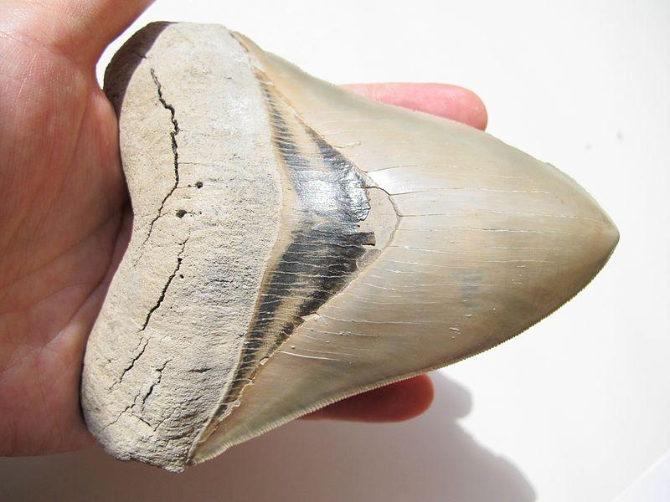
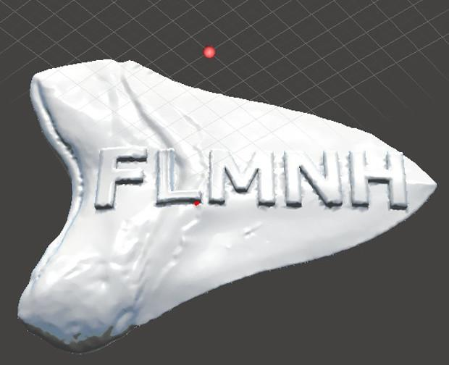
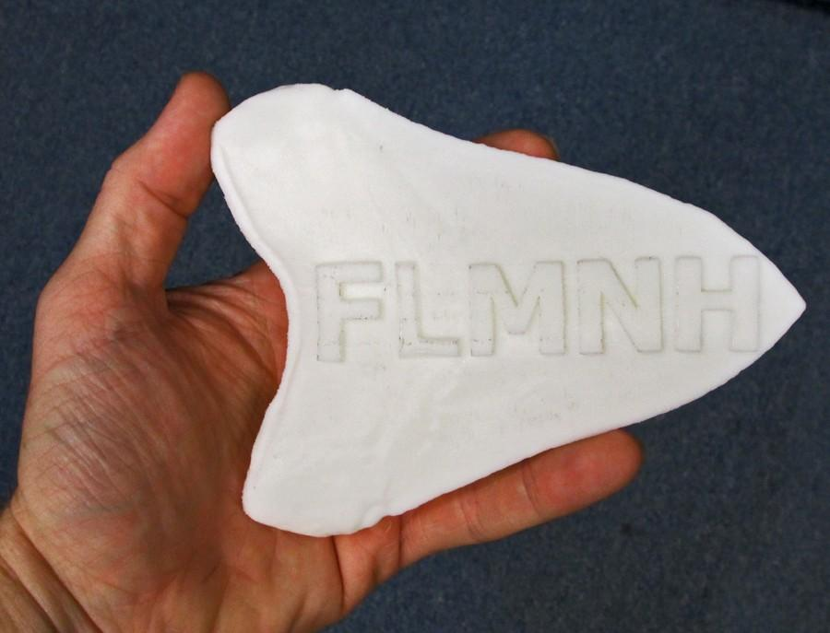
Image source: http://commons.wikimedia.org/wiki/File:Carcharocles_megalodon_tooth.JPG
Image source: Aaron Wood
Image source: Aaron Wood
3D Model printing by Robert Burns
Notes:
Here is a note

Slide 20
Recommended minimum Audubon Core fields for iDigBio Data Ingestion:
Access URI
Rights
Provider
Scientific name
Title
Description
Tags

Slide 21
Practical Details
Data Formats
ISO 8601 Dates
WGS84 Decimal Lat/Long
Controlled Vocabularies
ISO Country Names and Codes
State/Province names
Identifier Formats (UUID, ARK, URN, DOI, URI, URL, LSID, ...)
Copyright and Standard Licenses
Apple Core guidelines for herbaria
http://code.google.com/p/applecore/wiki/Introduction

Slide 22
Ingestion Process Changes Over the Past Year
New Staff (Dan Stoner… that’s me!)
Improved parallelization of ingestion tasks
Incremental Indexing
Database Tuning
Ingestion Reporting

Slide 23
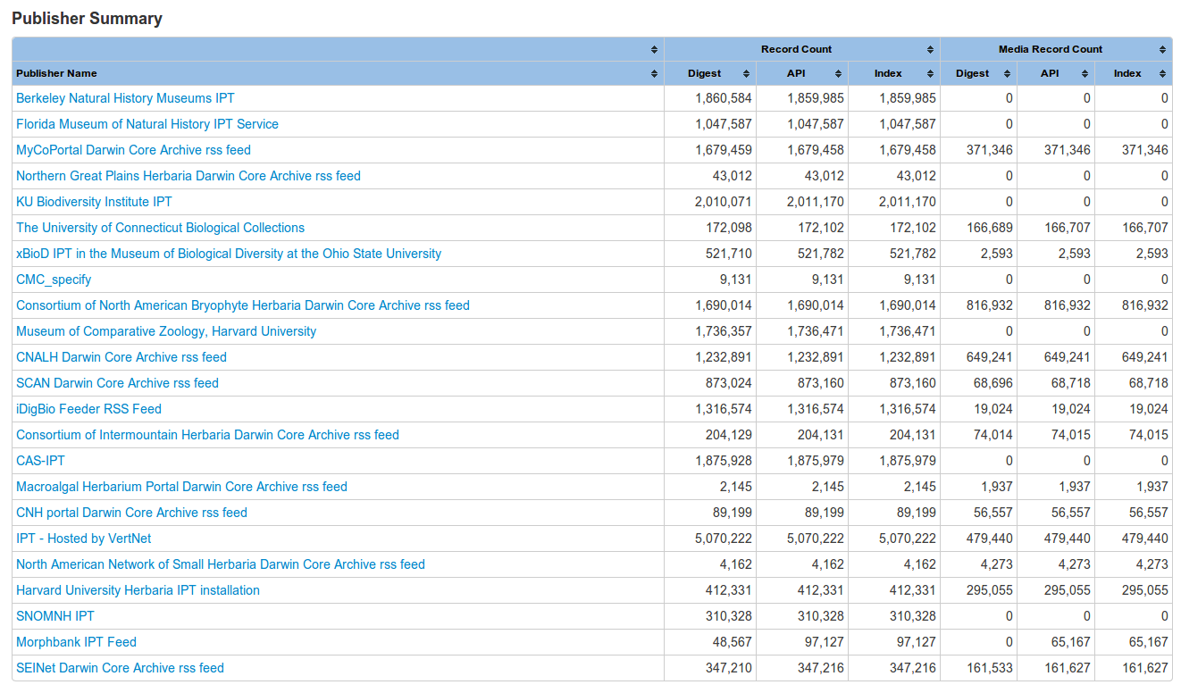
Ingestion Reporting
https://www.idigbio.org/portal/publishers

Slide 24
Planned Future Changes
Parallelize more parts of Ingestion process (such as media processing)
Support for additional publisher types (beyond IPT, Symbiota, iDigBio RSS Feeder)
Improved Ingestion logging and error detection
Support for additional media types (audio, 3D scans, …)
Data Quality

Slide 25
Thank You!

Slide 26
End.

